Slide 1
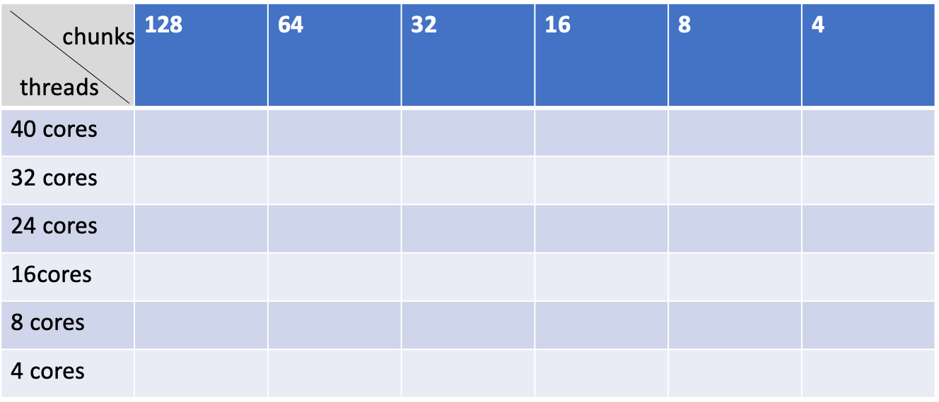
I did test on rotate with split_cores function:
1. test performance under different cores(2,4,8,16,32,40);
2. test performance with varying chunk numbers under different cores,
and the test pattern as following table shows:

Slide 2
outlines
part1 rotate_splitcores_without_chunksize changing
part2 rotate_splitcores_with_chunksize_changing
1. compare modified(splitecores) rotate with unmodified rotate under same chunk/cores number
2. performance of modified(splitcores) rotate with varying chunk numbers under specific cores

Slide 3
Part1 rotate_splitcores_without_chunksize
results shows: each test under different cores has a little bit of improvement (it did have the trend to move left)

Slide 5
splitcore Vs. normal rotate algorithm under specific core numbers = x

Slide 10
part2 rotate_splitcores_with_chunksize_changing

Slide 11
2-1.
compare modified(splitecores) rotate with unmodified rotate under same chunk/cores number

Slide 12
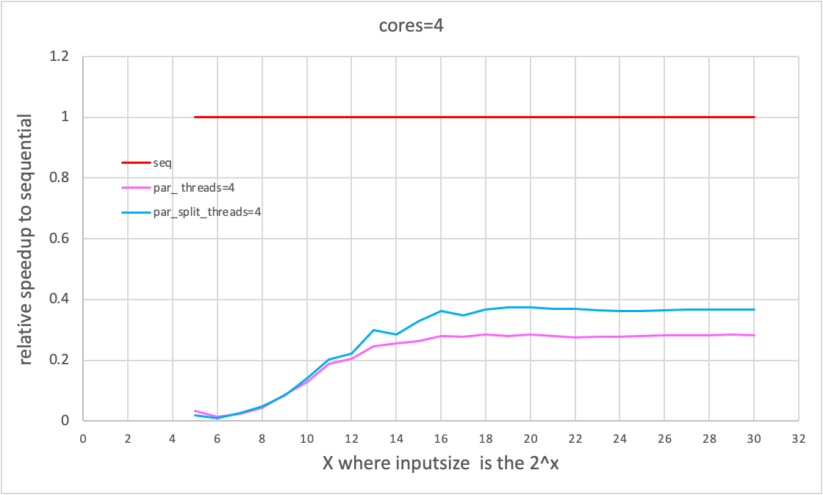
chunk number=4 cores=4

Slide 13
chunk number=8 cores=8

Slide 14
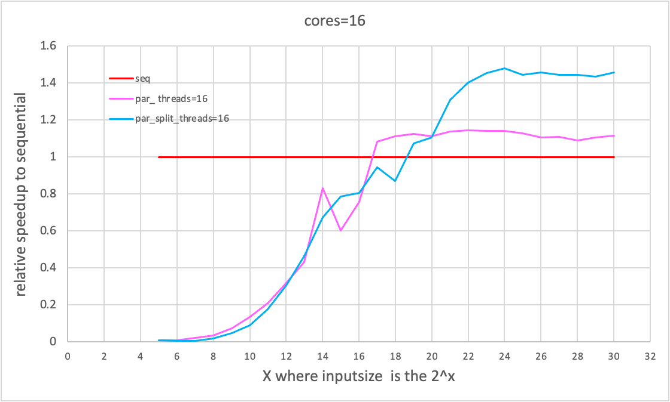
chunk number=16 cores=16

Slide 15
chunk number=32 cores=32

Slide 16
2-2
performance of modified(splitcores) rotate with varying chunk numbers under specific cores

Slide 17
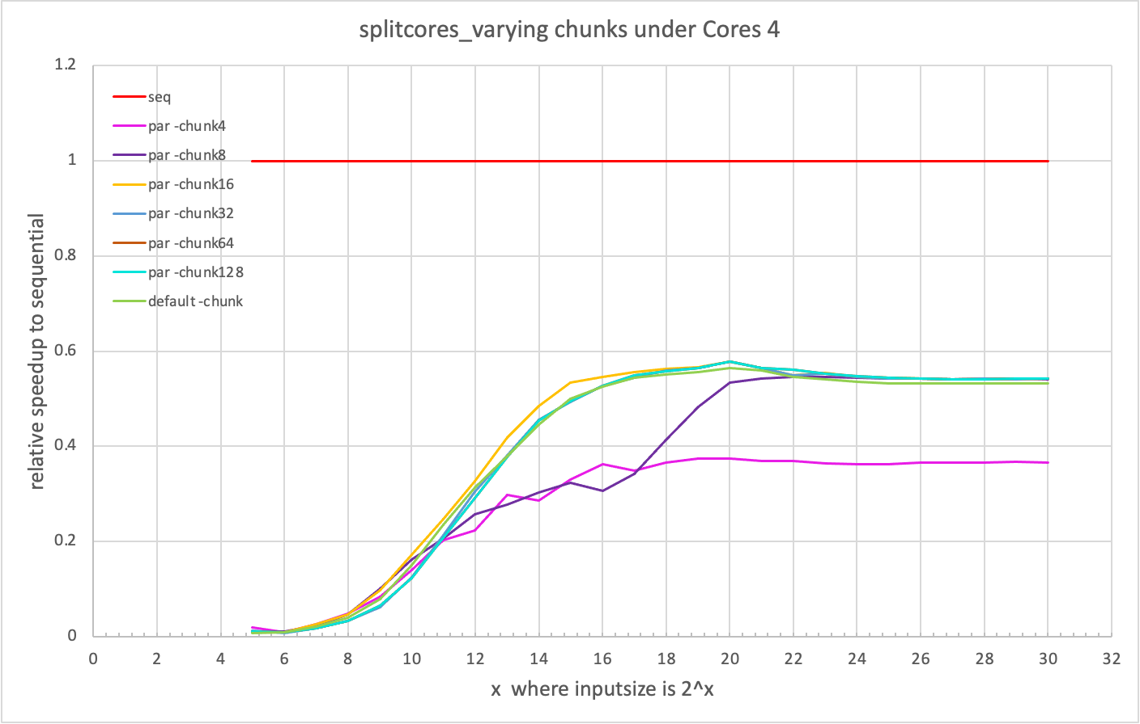

Slide 18
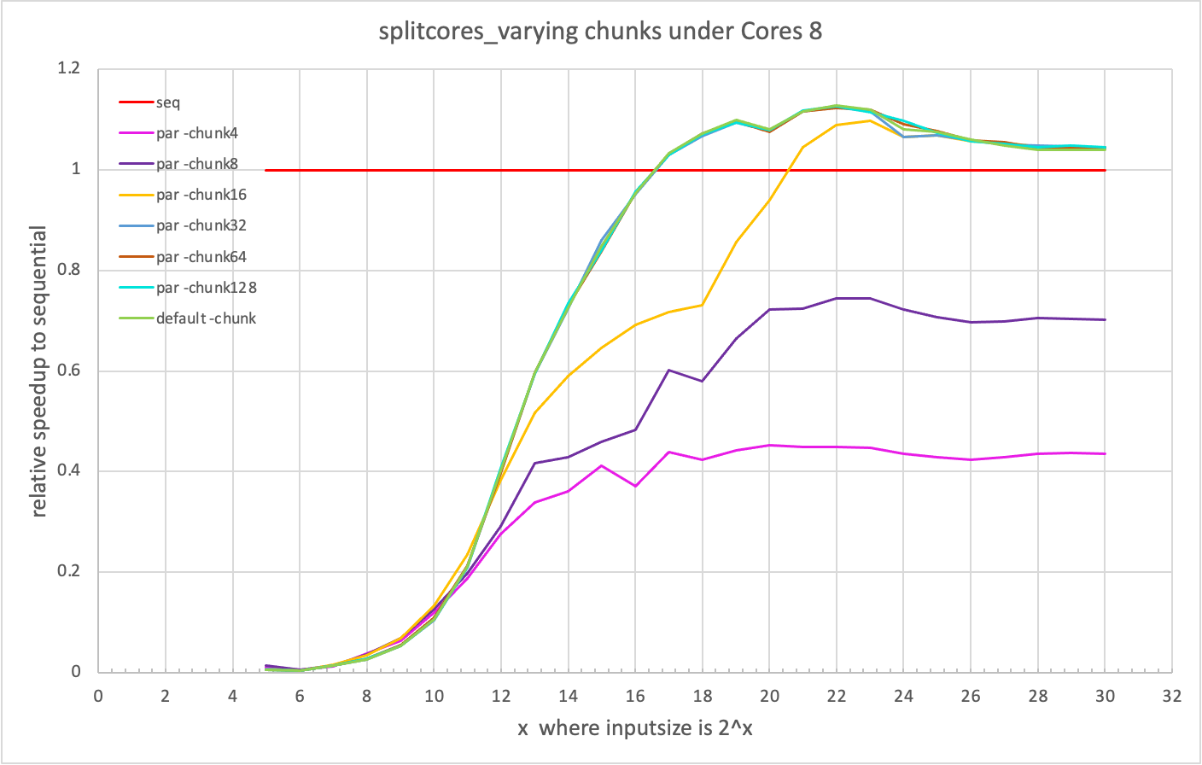

Slide 19
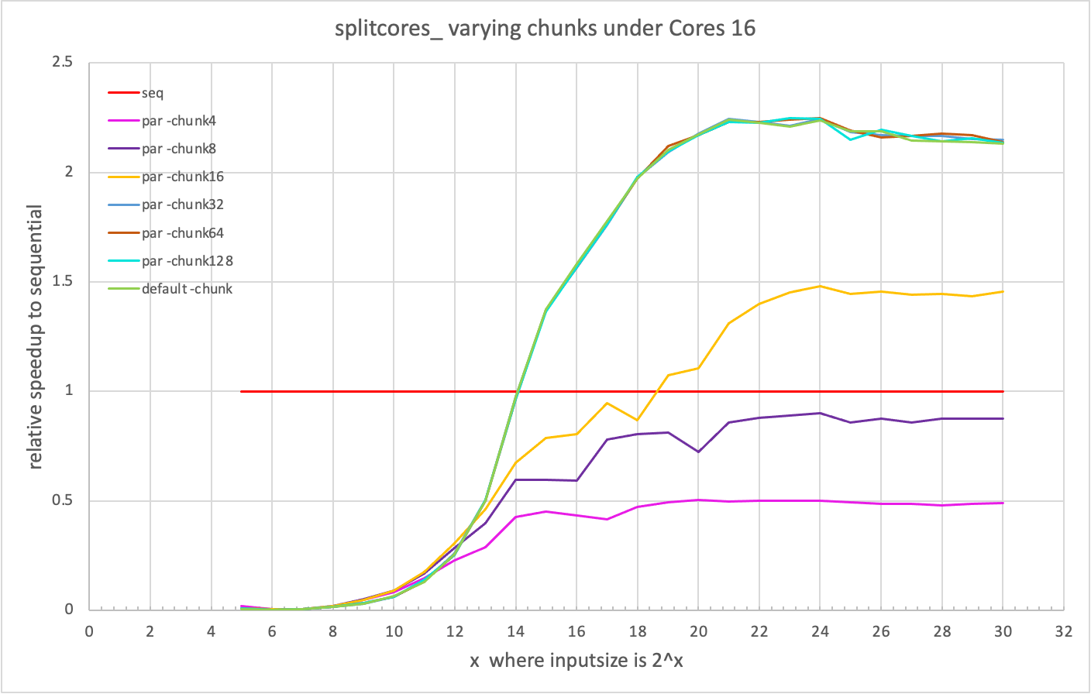

Slide 20
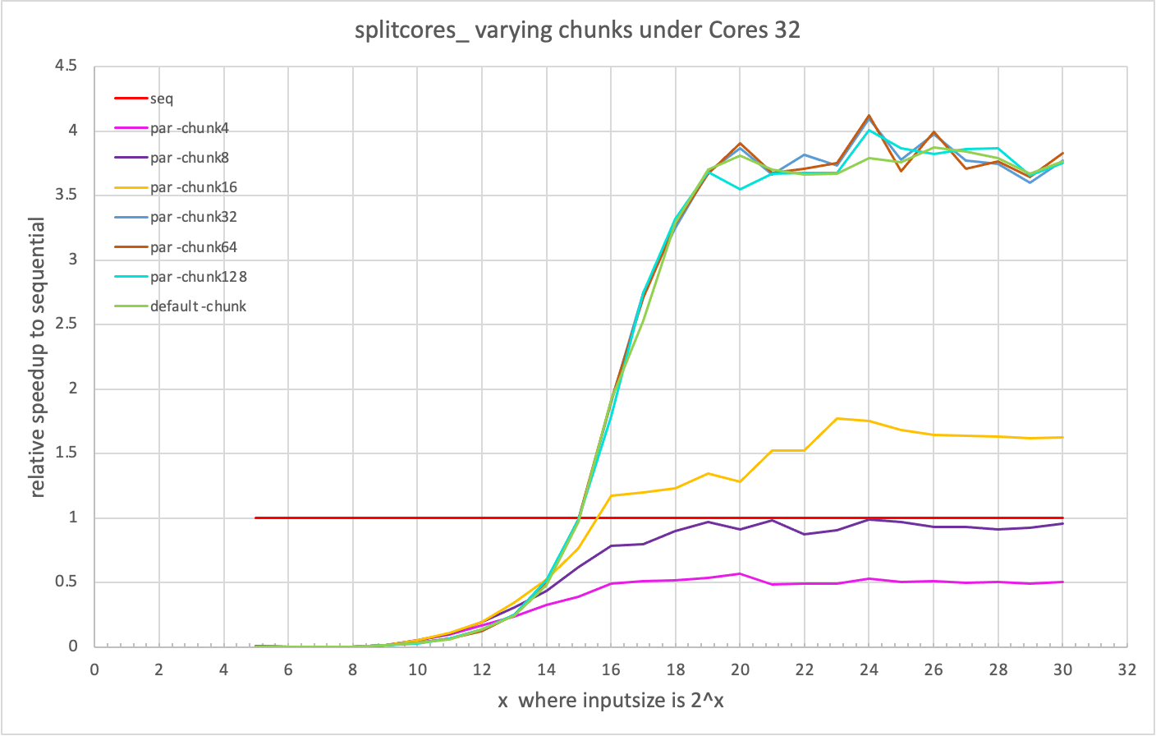

Slide 21
